Slide 1
Tutorial: Evaluate values from dynamically produced UI modules
Aaron Clark, Biogen

Slide 2
Agenda
The Problem
A Use Case
Dissect some Code
Conclusions

Slide 3
The Problem
There are a couple things that are difficult about this talk’s title:
{Evaluate user inputs from dynamically produced UI Modules}

Slide 4
The big three: (that I’ll cover at least)
Generating dynamic UI
Bringing user inputs together in parent module(s)
Evaluating the result
Notes:
The app is designed so that if you need to extend its functionalities, you could easily do so by creating shiny modules.
If you are interested in the app’s code, you can can request by email and I will work to make it available to you. We are also in the process of making it available on GitHub.

Slide 5
Our Goal
Let’s learn via an example that accomplishes all three

Slide 6
Use Case

Slide 7

Experimental R package available on GitHub
Exports one shiny module for users to include in existing apps
Handy UI to help’s users create new variables using simple or advance techniques
Evaluates user inputs into {dplyr} on the fly to create new columns in initial data source

Slide 8
60 Second Demo
Take it for a spin yourself:
Bit.ly/shinyNewColumns

Slide 9
App Structure

Slide 10


Internal modular structure
app.R
launchModal
newCol
rangeConditions

Slide 11
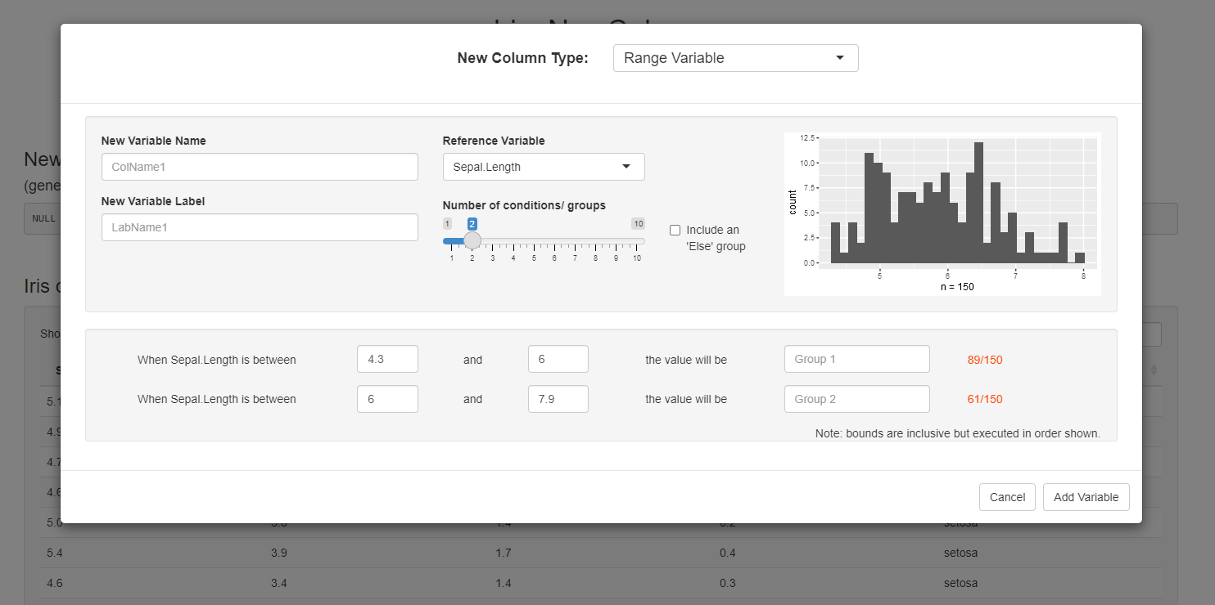
Modules as seen in the app
app.R
launchModal
newCol
Range
Conditions

Slide 12
Modules as seen in the app
app.R
launchModal
newCol
Range
Conditions

Slide 13
Modules as seen in the app
app.R
launchModal
newCol
Range
Conditions

Slide 14
Modules as seen in the app
app.R
launchModal
newCol
Range
Conditions

Slide 15
Modules as seen in the app
app.R
launchModal
newCol
Range
Conditions

Slide 16
Modules as seen in the app
app.R
launchModal
newCol
Range
Conditions

Slide 17
Module Activity Generating UI, inputs/ outputs, evaluation

Slide 18
Module Activity
app.R
launchModal
newCol
rangeConditions

Slide 19
Module Activity
app.R
launchModal
newCol
rangeConditions

Slide 20
What you see:
app.R
library(shinyNewColumns)
UI:
mod_launchModal_ui(“snc")
Server:
out <- mod_launchModal_srv("snc", data)

Slide 21
What you see:
app.R
library(shinyNewColumns)
UI:
mod_launchModal_ui(“snc")
Server:
out <- mod_launchModal_srv("snc", data)
Call in global.R or perhaps as a prefix
shinyNewColumns::mod_launchModal_*

Slide 22
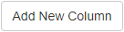
What you see:
app.R
library(shinyNewColumns)
UI:
mod_launchModal_ui(“snc")
Server:
out <- mod_launchModal_srv("snc", data)
UI Module simply
accepts the ‘id’ arg and creates a button:

Slide 23
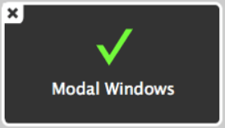
What you see:
app.R
library(shinyNewColumns)
UI:
mod_launchModal_ui(“snc")
Server:
out <- mod_launchModal_srv("snc", data)
Server Module launches the modal

Slide 24
Module Activity
app.R
launchModal
newCol
rangeConditions

Slide 25
Module Activity
launchModal
_____UI:_____
_____Server:_____
app.R
newCol

Slide 26

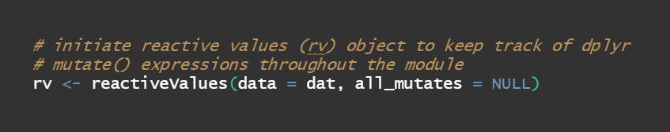
Module Activity
launchModal
dat (iris)
_____Server:_____
app.R
newCol

Slide 27
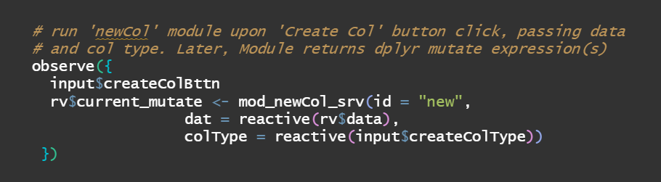
Module Activity
launchModal
dat (iris)
_____Server:_____
app.R
newCol
rv$data

Slide 28
Module Activity
newCol
_____UI:_____
launchModal
Range
Conditions

Slide 29
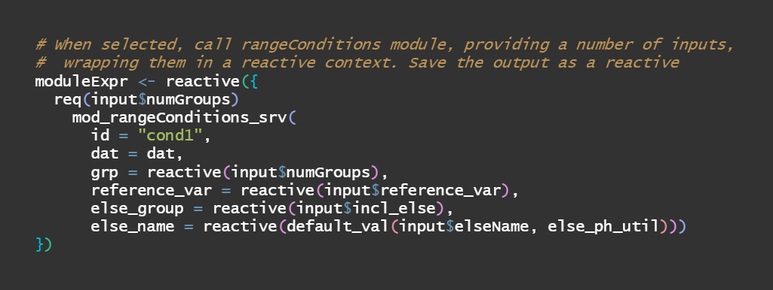
Module Activity
newCol
dat
_____Server:_____
launchModal
Range
Conditions

Slide 30
Module Activity
rangeConditions
_____UI:_____
newCol

Slide 31
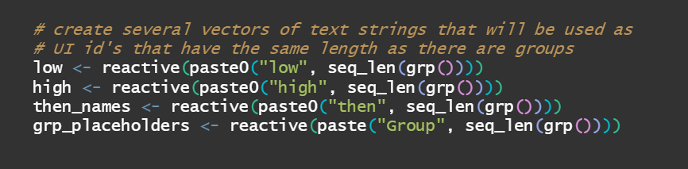
Module Activity
rangeConditions
dat + every UI element from newCol
Server: dynamic UI time!
newCol
Step 1: reactive text strings for shiny input ids!

Slide 32
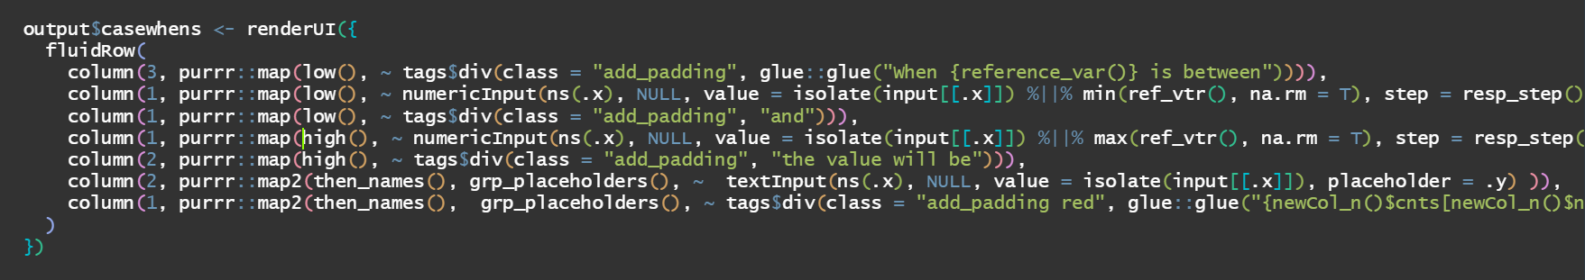
Module Activity
rangeConditions
Use purrr::map()

Slide 33
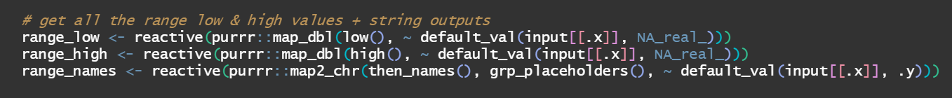
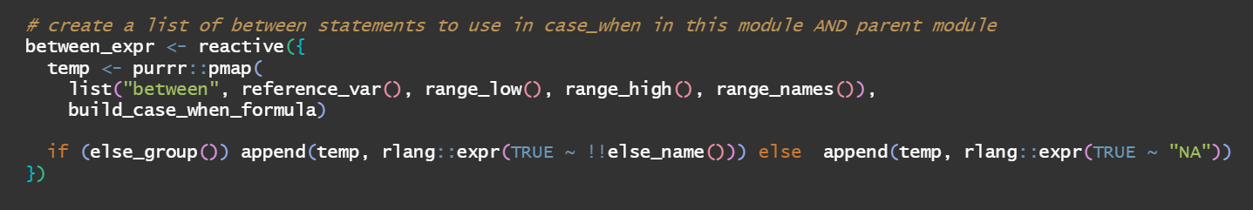
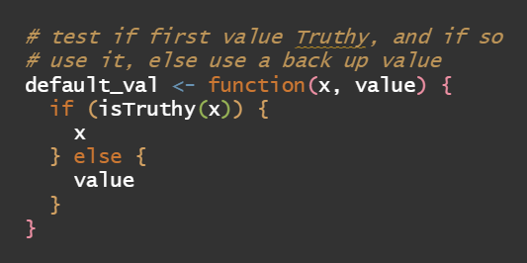
Module Activity
rangeConditions
Again, use purrr::map() suite of functions

Slide 34
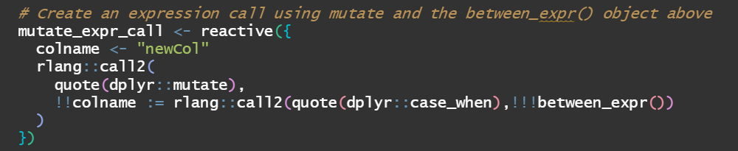
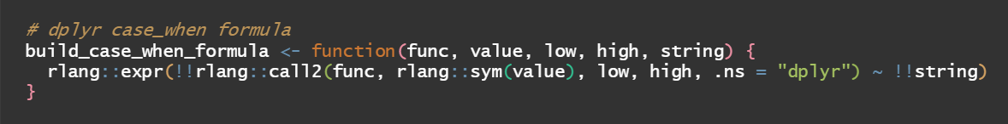
Module Activity
rangeConditions
We will return this obj later
But for now, we’ll start eval in this
module to display
row counts
Enter: call2(quote())

Slide 35
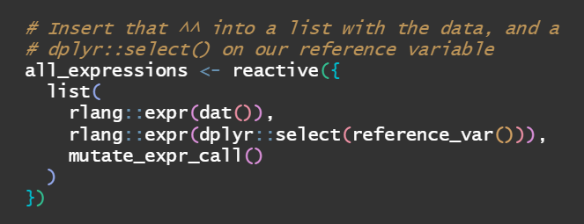
Module Activity
rangeConditions
Pull all expressions into a list()

Slide 36
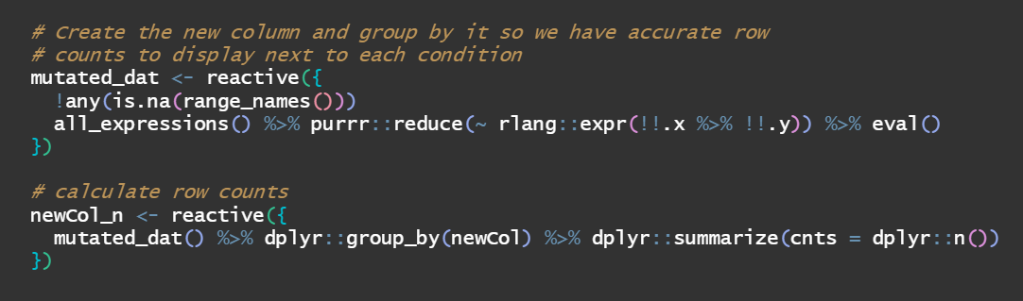
Module Activity
rangeConditions
purrr::reduce helps us pipe each expr, and base::eval() brings us home

Slide 37
Module Activity
rangeConditions
newCol

Slide 38
Module Activity
rangeConditions
Time to pass objects back up! Yay!
newCol

Slide 39
Module Activity
newCol
launchModal
Range
Conditions

Slide 40
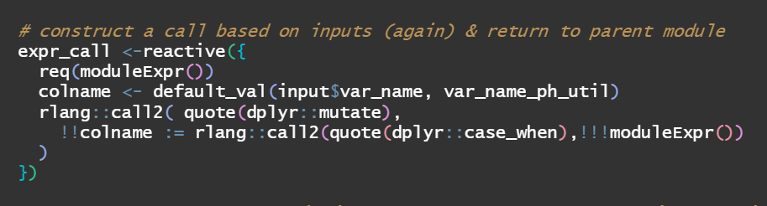
Module Activity
newCol
launchModal
Range
Conditions

Slide 41
Module Activity
launchModal
app.R
newCol

Slide 42
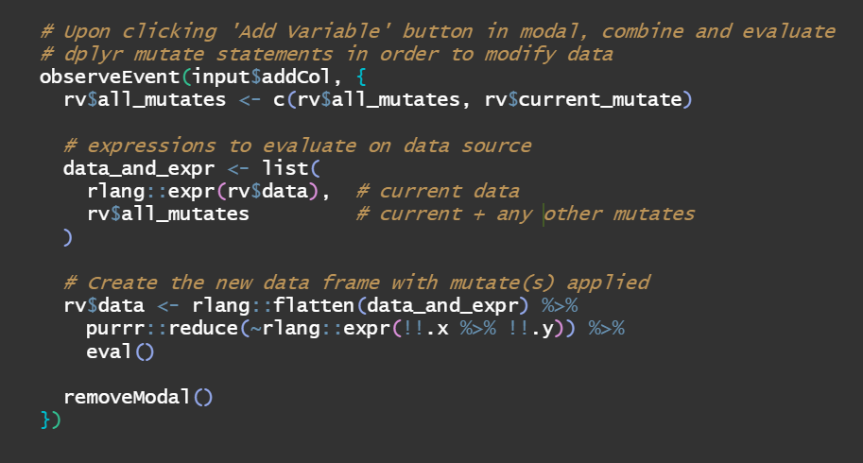
Module Activity
launchModal
app.R
newCol

Slide 43
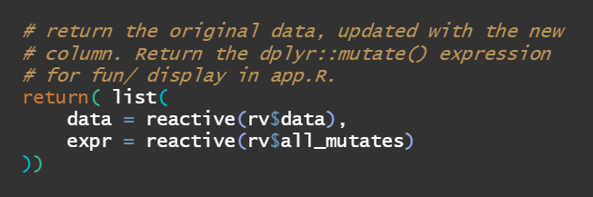
Module Activity
launchModal
app.R
newCol

Slide 44
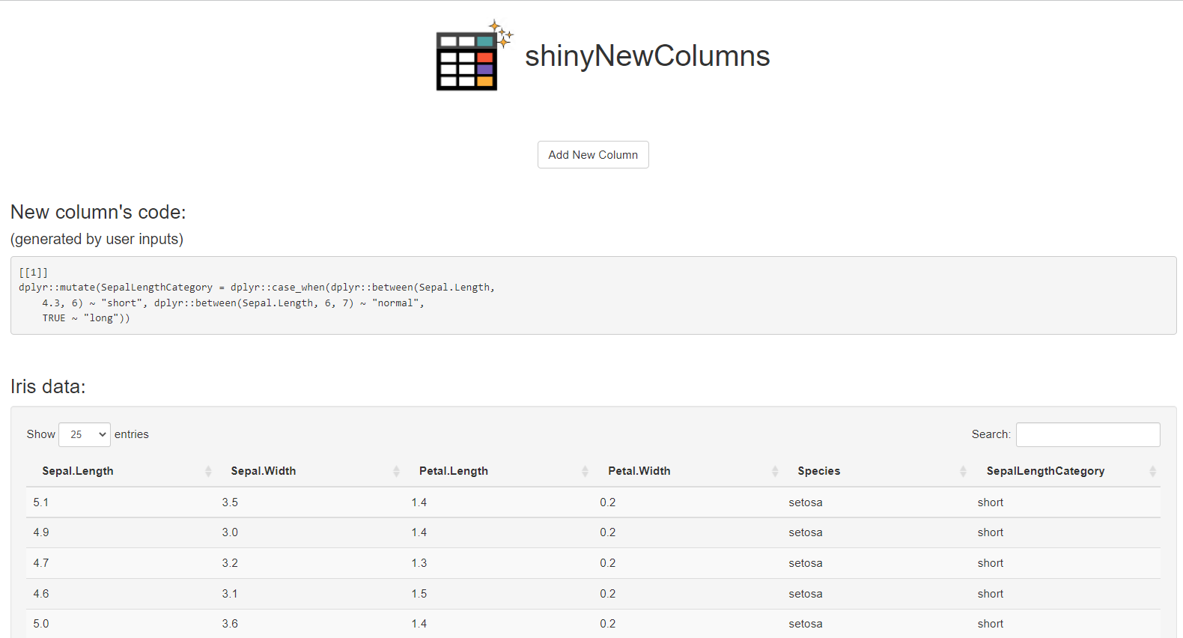


Module Activity
app.R
We did it
launchModal

Slide 45
Internal modular structure
app.R
launchModal
newCol
rangeConditions

Slide 46
What have we learned?
There are a couple things that are difficult about this talk’s title:
{Evaluate user inputs from dynamically produced UI Modules}

Slide 47
The big three: (that I’ll covered at least)
Generating dynamic UI
Bringing user inputs together in parent module(s)
Evaluating the result
Notes:
The app is designed so that if you need to extend its functionalities, you could easily do so by creating shiny modules.
If you are interested in the app’s code, you can can request by email and I will work to make it available to you. We are also in the process of making it available on GitHub.

Slide 48
Generating dynamic UI
Use…
reactive id names
purrr::map() suite of functions
Notes:
The app is designed so that if you need to extend its functionalities, you could easily do so by creating shiny modules.
If you are interested in the app’s code, you can can request by email and I will work to make it available to you. We are also in the process of making it available on GitHub.

Slide 49
Bringing user inputs together in parent modules
Combine each iterative UI into it’s own expression
Put them all in a list
Return the result
Notes:
The app is designed so that if you need to extend its functionalities, you could easily do so by creating shiny modules.
If you are interested in the app’s code, you can can request by email and I will work to make it available to you. We are also in the process of making it available on GitHub.

Slide 50
Evaluating those inputs
Enter {rlang} to save the day: made heavy use of call2(), expr(), sym()
Base R is great too thank to: quote() & good old fashion eval()
Notes:
The app is designed so that if you need to extend its functionalities, you could easily do so by creating shiny modules.
If you are interested in the app’s code, you can can request by email and I will work to make it available to you. We are also in the process of making it available on GitHub.

Slide 51
Evaluating those inputs
Steps …
Use rlang::call2(quote()) on the returned expressions
Put those in a list
Use purrr::flatten & reduce to pipe each element into eval()
Notes:
The app is designed so that if you need to extend its functionalities, you could easily do so by creating shiny modules.
If you are interested in the app’s code, you can can request by email and I will work to make it available to you. We are also in the process of making it available on GitHub.

Slide 52
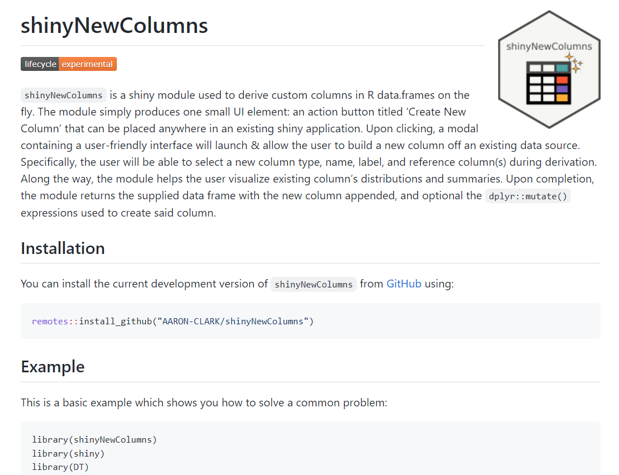
Check out the project
https://github.com/AARON-CLARK/shinyNewColumns
Notes:
Now that we have an idea of how useful it is tidyCDSIC, I’ll leave the floor to my college Maya to give you a demo of the app.
You can follow Maya’s demo by going to the live application at

Slide 53




A Collaborative Effort
Aaron Clark | Maya Gans
| You?
Open a PR!
Notes:
We cannot finish our presentation without acknowledging the rest of the team.
Thank you Aaron, Bob, Robert, and Nate

Slide 54


Let’s connect
Aaron Clark
clark.aaronchris@gmail.com
Notes:
We cannot finish our presentation without acknowledging the rest of the team.
Thank you Aaron, Bob, Robert, and Nate

Slide 55
{shinyNewColumns}
An open source platform in R shiny to derive custom columns on the fly

